Slide 1


DEPARTMENT OF COMPUTER SCIENCE & ENGINEERING
(ARTIFICIAL INTELLIGENCE & MACHINE LEARNING)
A.P. SHAH INSTITUTE OF TECHNOLOGY
G.B. ROAD, KASARVADAVALI, THANE (WEST) – 400 615
UNIVERSITY OF MUMBAI
ACADEMIC YEAR 2024 - 2025

Slide 2

Team Members:
Manasi Patil (22106042)
Samiksha Patil (22106041)
Smith Patil (23206010)
Major Project Guide: Dr. Jaya Gupta

Slide 3

Goal Alignment with UN SDG:
•Improves stock forecasting by integrating real-time public sentiment for better decision-making.
•Empowers retail investors with accessible, sentiment-driven financial insights.
•Helps reduce market volatility by anticipating sentiment-induced economic shocks.
•Promotes innovation through the use of AI and NLP in financial forecasting.

Slide 4
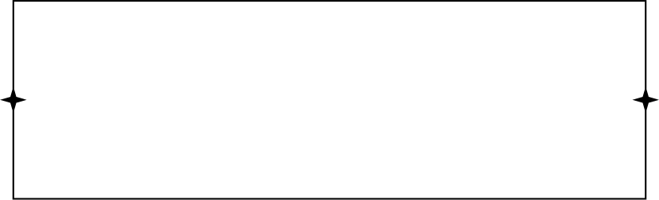
Sentiment - Augmented Stock Price Forecasting
Introducing an intelligent stock recommendation system designed for investors.
Provides personalized recommendations (company & risk level) based on a user's age and investment amount.
Simplifies complex investment decisions by automating sophisticated market analysis.
Offers a holistic view of each stock, combining quantitative price forecasts with qualitative news insights.

Slide 5
Problem Statement:
Beginners often struggle with market complexity, lacking tools to forecast prices, gauge news sentiment, or align investments with their personal risk tolerance. Our system solves this by automating the analysis, delivering personalized, risk-assessed recommendations by hybridizing LSTM-GA price predictions with real-time FinBERT sentiment scores.

Slide 6
Objectives:
To provide personalized, risk-based stock recommendations.
To accurately forecast stock prices using a hybrid LSTM-GA model.
To analyze real-time financial news sentiment using a custom FinBERT model.
To integrate all features into a single, cohesive recommendation system.

Slide 7
Literature Survey:
Sr. No. | Authors | Title | Summary | Limitation
1. | Yunus Emre GÜR (2024) | Comparative Analysis of Deep Learning Models for Silver Price Prediction: CNN, LSTM, GRU and Hybrid Approach | Hybrid CNN-LSTM-GRU model outperforms individual deep learning models in predicting silver prices. | 1] Hybrid model is computationally intensive. 2] The study overlooks external factors limiting prediction accuracy.
2. | Wen jun Gu, Yi hao Zhong, Shi zun Li, Chang song Wei, Li ting Dong, Zhuo yue Wang, Chao Yan (2024) | Predicting Stock Prices with FinBERT – LSTM: Integrating News Sentiment Analysis | Hybrid deep learning model (FinBERT - LSTM) for stock price prediction by integrating historical stock data and financial news sentiment. | No mechanism to filter misinformation, which could mislead predictions.

Slide 8
Literature Survey:
Sr. No. | Authors | Title | Summary | Limitation
3. | Ali Mohammadjafari 2024 | Comparative Study of Bitcoin Price Prediction | GRU outperformed LSTM in predicting Bitcoin prices, proving more accurate and efficient | Only LSTM and GRU were tested – other models might perform better.
4. | Zhuang Liu, Degen Huang, Kaiyu Huang, Zhuang Li, Jun Zhao (2021) | FinBERT: A Pre – trained Financial Language Representation Model for Financial Text Mining | FinBERT improves financial text mining by combining domain specific pre-training, multi-task learning, making it more accurate and robust than standard BERT. | Pre-training needs massive amounts of data, not always available in specialized finance sub-domains.

Slide 9
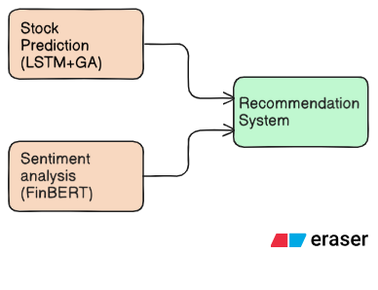
Flowchart - Overall System Diagram

Slide 10
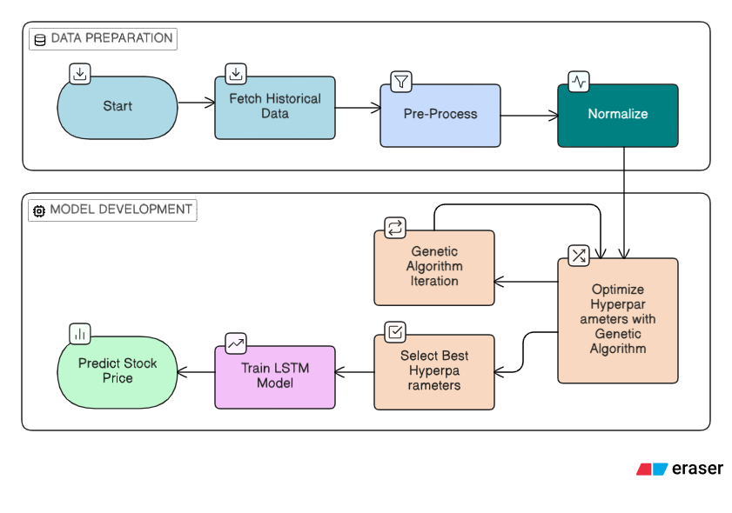
Flowchart - Stock Price Prediction

Slide 11
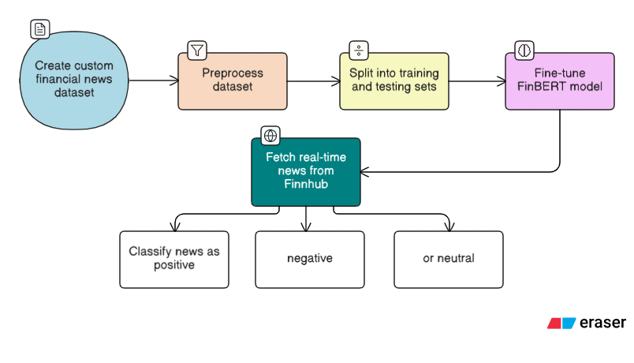
Flowchart - Sentiment Score Calculation

Slide 12
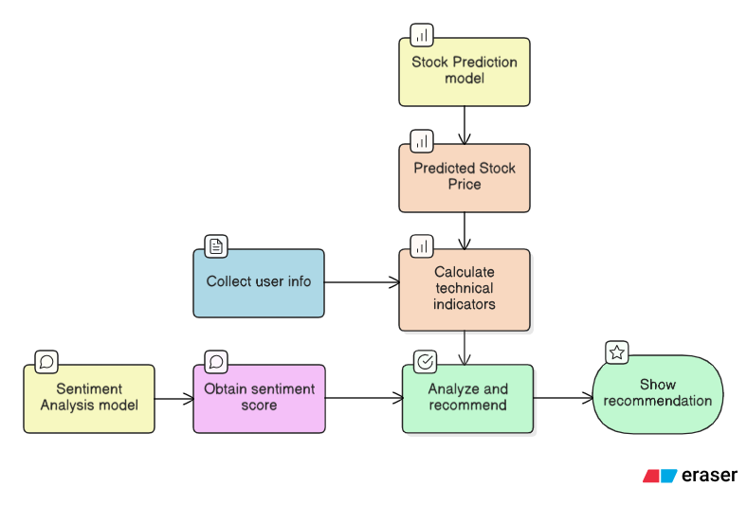
Flowchart - Recommendation System

Slide 13
Technology Stack:
1] Programming Language: Python
2] Backend Framework: Flask
3] Algorithm: Genetic Algorithm
Long Short Term Memory
4] Model: FinBERT

Slide 14
Datasets:
1] Yahoo! Finance /YFinance: Historical market data via Python library
2]Loughran–McDonald Financial Sentiment Word Lists
3] FinnHub: Financial data API for real time market news

Slide 15
References:
[1] Yunus Emre GÜR (2024) Comparative Analysis of Deep Learning Models for Silver Price Prediction: CNN, LSTM, GRU and Hybrid Approach
https://doi.org/10.25294/auiibfd.1404173
[2] Wenjun Gu, Yihao Zhong, Shizun Li, Changsong Wei, Liting Dong, Zhuoyue Wang, Chao Yan (2024) Predicting Stock Prices with FinBERT-LSTM: Integrating News Sentiment Analysis
https://doi.org/10.48550/arXiv.2407.16150
[3] Ali Mohammadjafari (2024) Comparative Study of Bitcoin Price Prediction
https://doi.org/10.48550/arXiv.2405.08089
[4] Zhuang Liu, Degen Huang, Kaiyu Huang, Zhuang Li, Jun Zhao (2021) FinBERT: A Pre-trained Financial Language Representation Model for Financial Text Mining
https://doi.org/10.24963/ijcai.2020/622

